Slide 1
Lecture 9
Creating Microsoft Azure Account
Instructor : Engr. Tehmeed

Slide 2
Create an Azure account
You can purchase Azure access directly from Microsoft by signing up on the Azure website or through a Microsoft representative. You can also purchase Azure access through a Microsoft partner. Cloud Solution Provider partners offer a range of complete managed-cloud solutions for Azure.

Slide 3
What is the Azure free account?
The Azure free account includes:
• Free access to popular Azure products for 12 months.
• A credit to use for the first 30 days.
• Access to more than 25 products that are always free.
The Azure free account is an excellent way for new users to get started and explore. To sign up, you need a phone number, a credit card, and a Microsoft or GitHub account. The credit card information is used for identity verification only. You won't be charged for any services until you upgrade to a paid subscription.

Slide 4
What is the Azure free student account?
The Azure free student account offer includes:
• Free access to certain Azure services for 12 months.
• A credit to use in the first 12 months.
• Free access to certain software developer tools.
The Azure free student account is an offer for students that gives $100 credit and free developer tools. Also, you can sign up without a credit card.

Slide 5
Steps to create Azure free student account?
To create a Microsoft Azure account, first visit the Azure website and click "Start free". You'll need to sign in with an existing Microsoft account or create a new one. After signing in, you'll be guided through the sign-up process, which includes providing personal details and payment information.
Here's a more detailed breakdown:
Go to the Azure website: Navigate to the Azure homepage.
Start Free: Click on the "Start free" button.
Sign in or create an account: If you have a Microsoft account, sign in. Otherwise, create a new one.
Provide details: Follow the on-screen instructions to provide your personal information, contact details, and payment method.
Verify your account: You may need to verify your phone number or email address through an OTP.
Accept the terms: Review and accept the Microsoft Azure terms and conditions.
Start exploring: Once your account is created, you can start exploring the Azure Portal and its services.

Slide 6
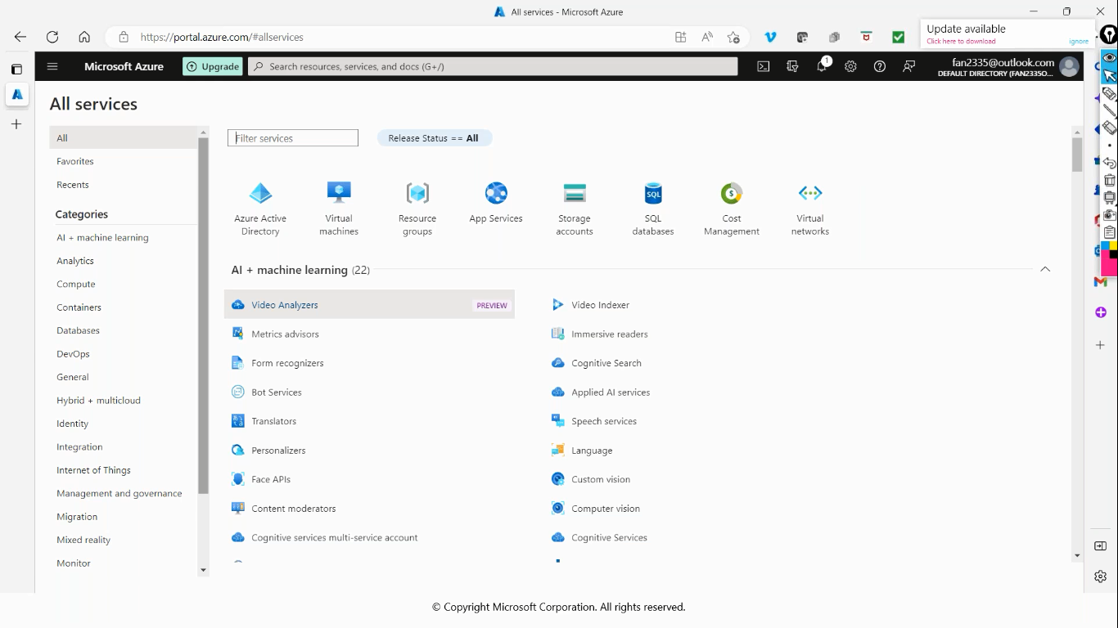
Steps to create Azure free student account?

Slide 7

Any Questions ?

